Slide 1
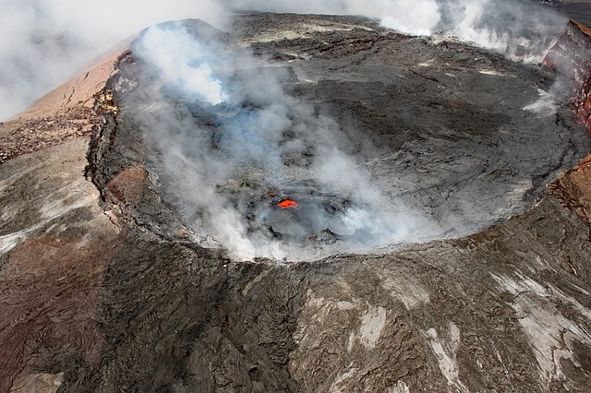
TROUBLE IN PARADISE:
Hawai’i in true and false colors
To boldly go where some algorithms have gone before...
Image by Tommy Beatty from Pixabay

Slide 2

I
III
MOTIVATION
ENHANCED MAPPING WITH PCA
II
IV
THE DATA
LANDSCAPE CLUSTERING

Slide 3
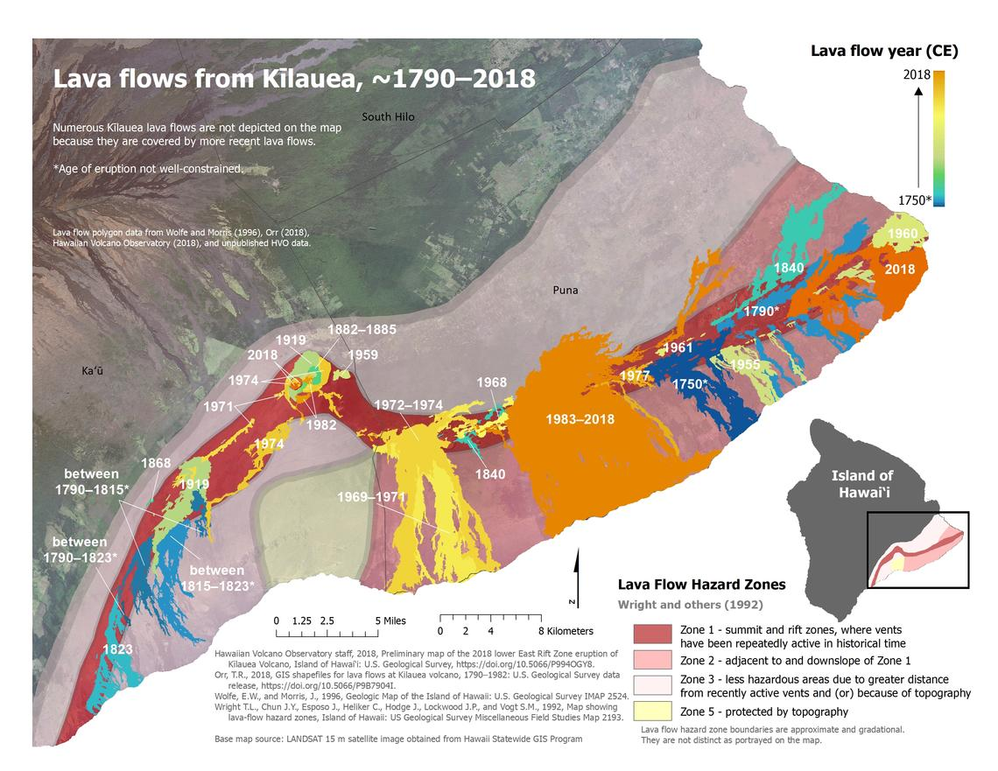
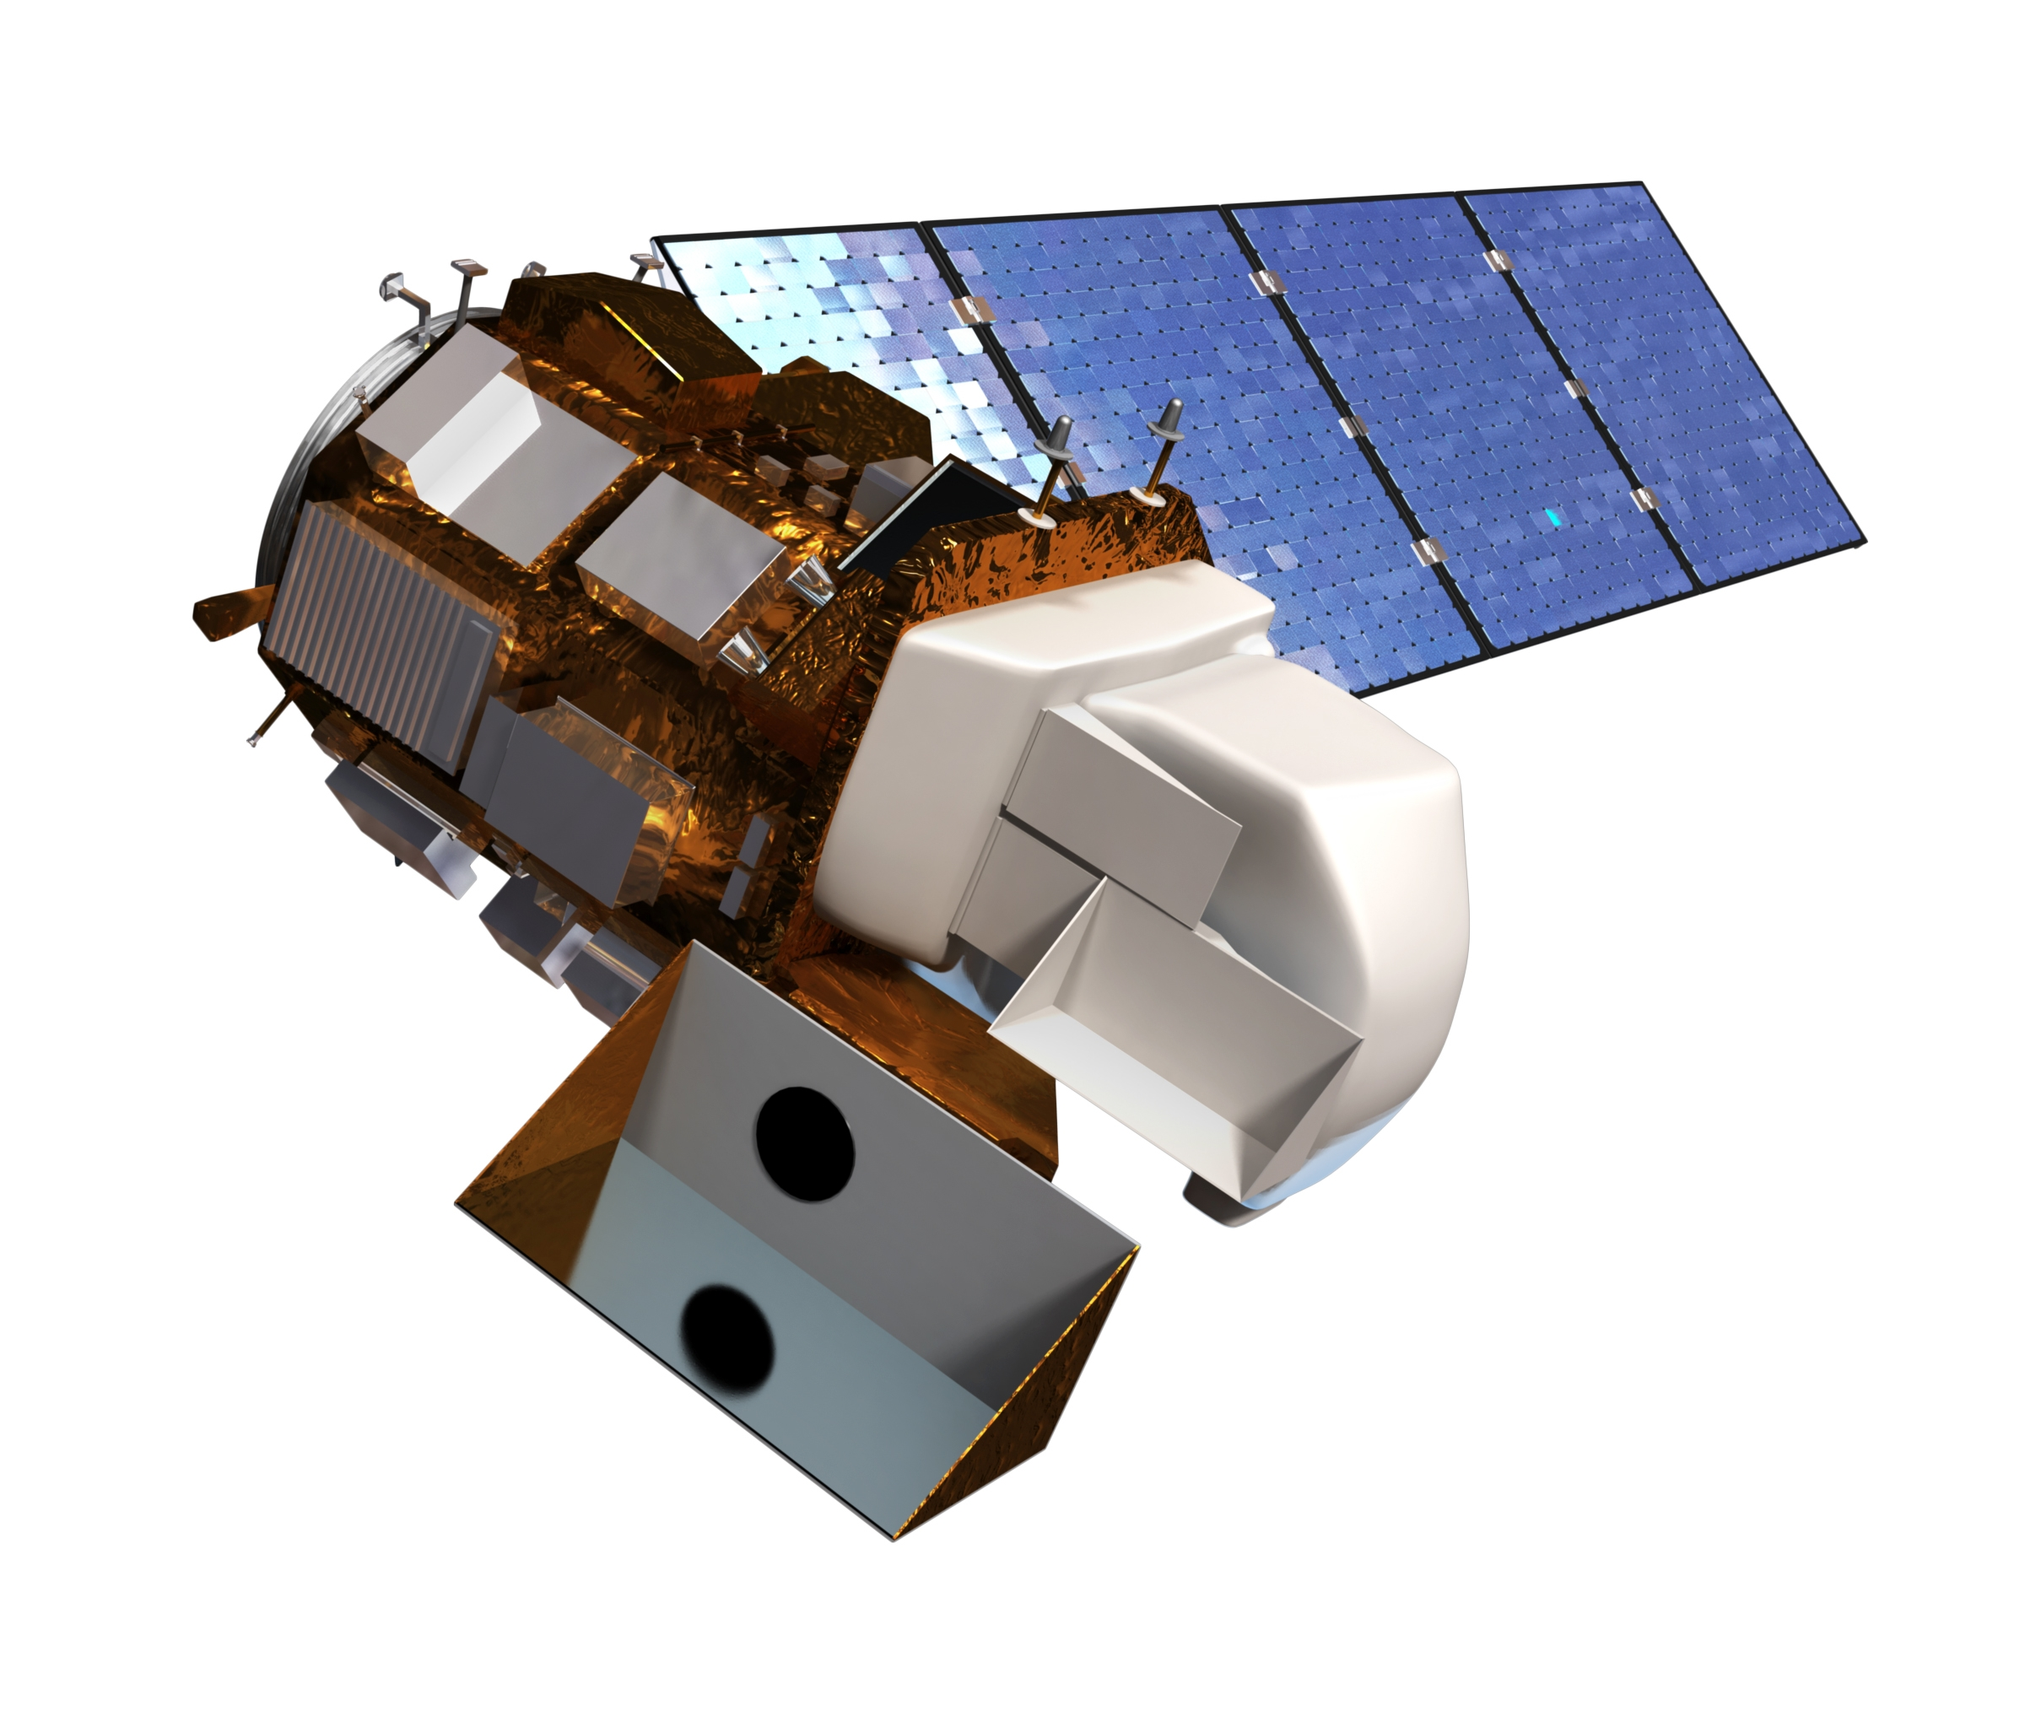
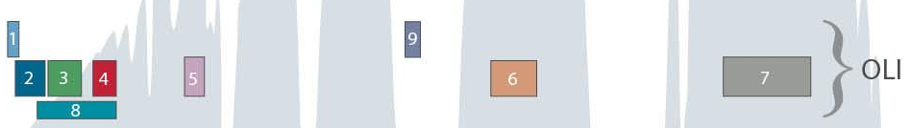
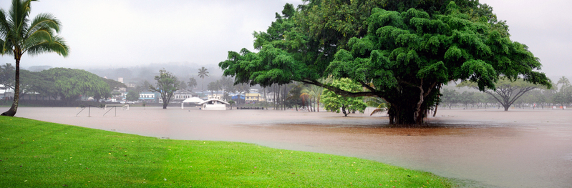
MOTIVATION
Landsat 8
Operational Land Imager (OLI)
MOTIVATION
Regression problem: estimate / predict lava flow ages from multispectral data.
Applications to volcanic hazards. Similar techniques could monitor vegetation response to contamination.
Start by looking at principal component analysis to reduce dimensionality of spectral data.
Study clustering in spectral data to identify landscape type (forest, fresh lava…) and clustering in spatial + spectral data to identify individual objects / features (lava flows).

Slide 4
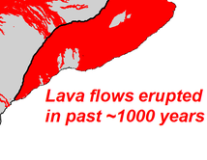
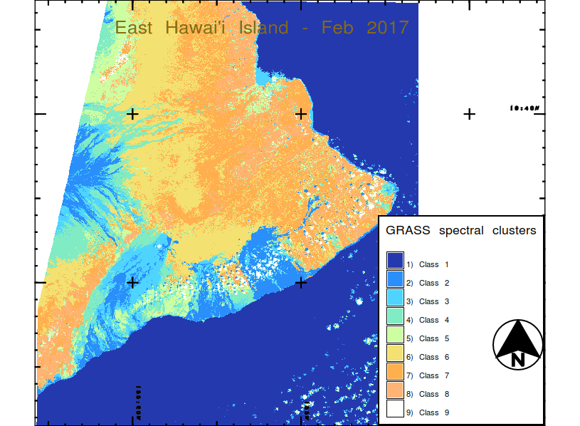
MOTIVATION
Landsat 8
Operational Land Imager (OLI)
MOTIVATION
Use multispectral data (visible and infrared) to distinguish lava flow ages.
Infrared spectra are filthy rich with data about vegetation, soil, and rock.
Principal Component Analysis (PCA) to reduce spectral dimensionality.
Clustering to identify
landscape spectral class (forest, fresh lava…).
spatial + spectral objects / features (single lava flow).
Example of GRASS GIS spectral classification on Landsat 8 data

Slide 5
MOTIVATION
Landsat 8
Operational Land Imager (OLI)
THE DATA
Landsat 8 OLI: 30 m per pixel, bands 1-7 used in this analysis.
Infrared band 5 is sensitive to vegetation.
IR band 6 / 7 used to study geologic materials.
Clouds are the bane of the remote sensing analyst.
Kilauea is on the windward side of Hawai’i Island.
All the analyses in this presentation were done on a single Landsat 8 scene collected in February 2017, a rare relatively cloudless day in Hilo / Kilauea.

Slide 6
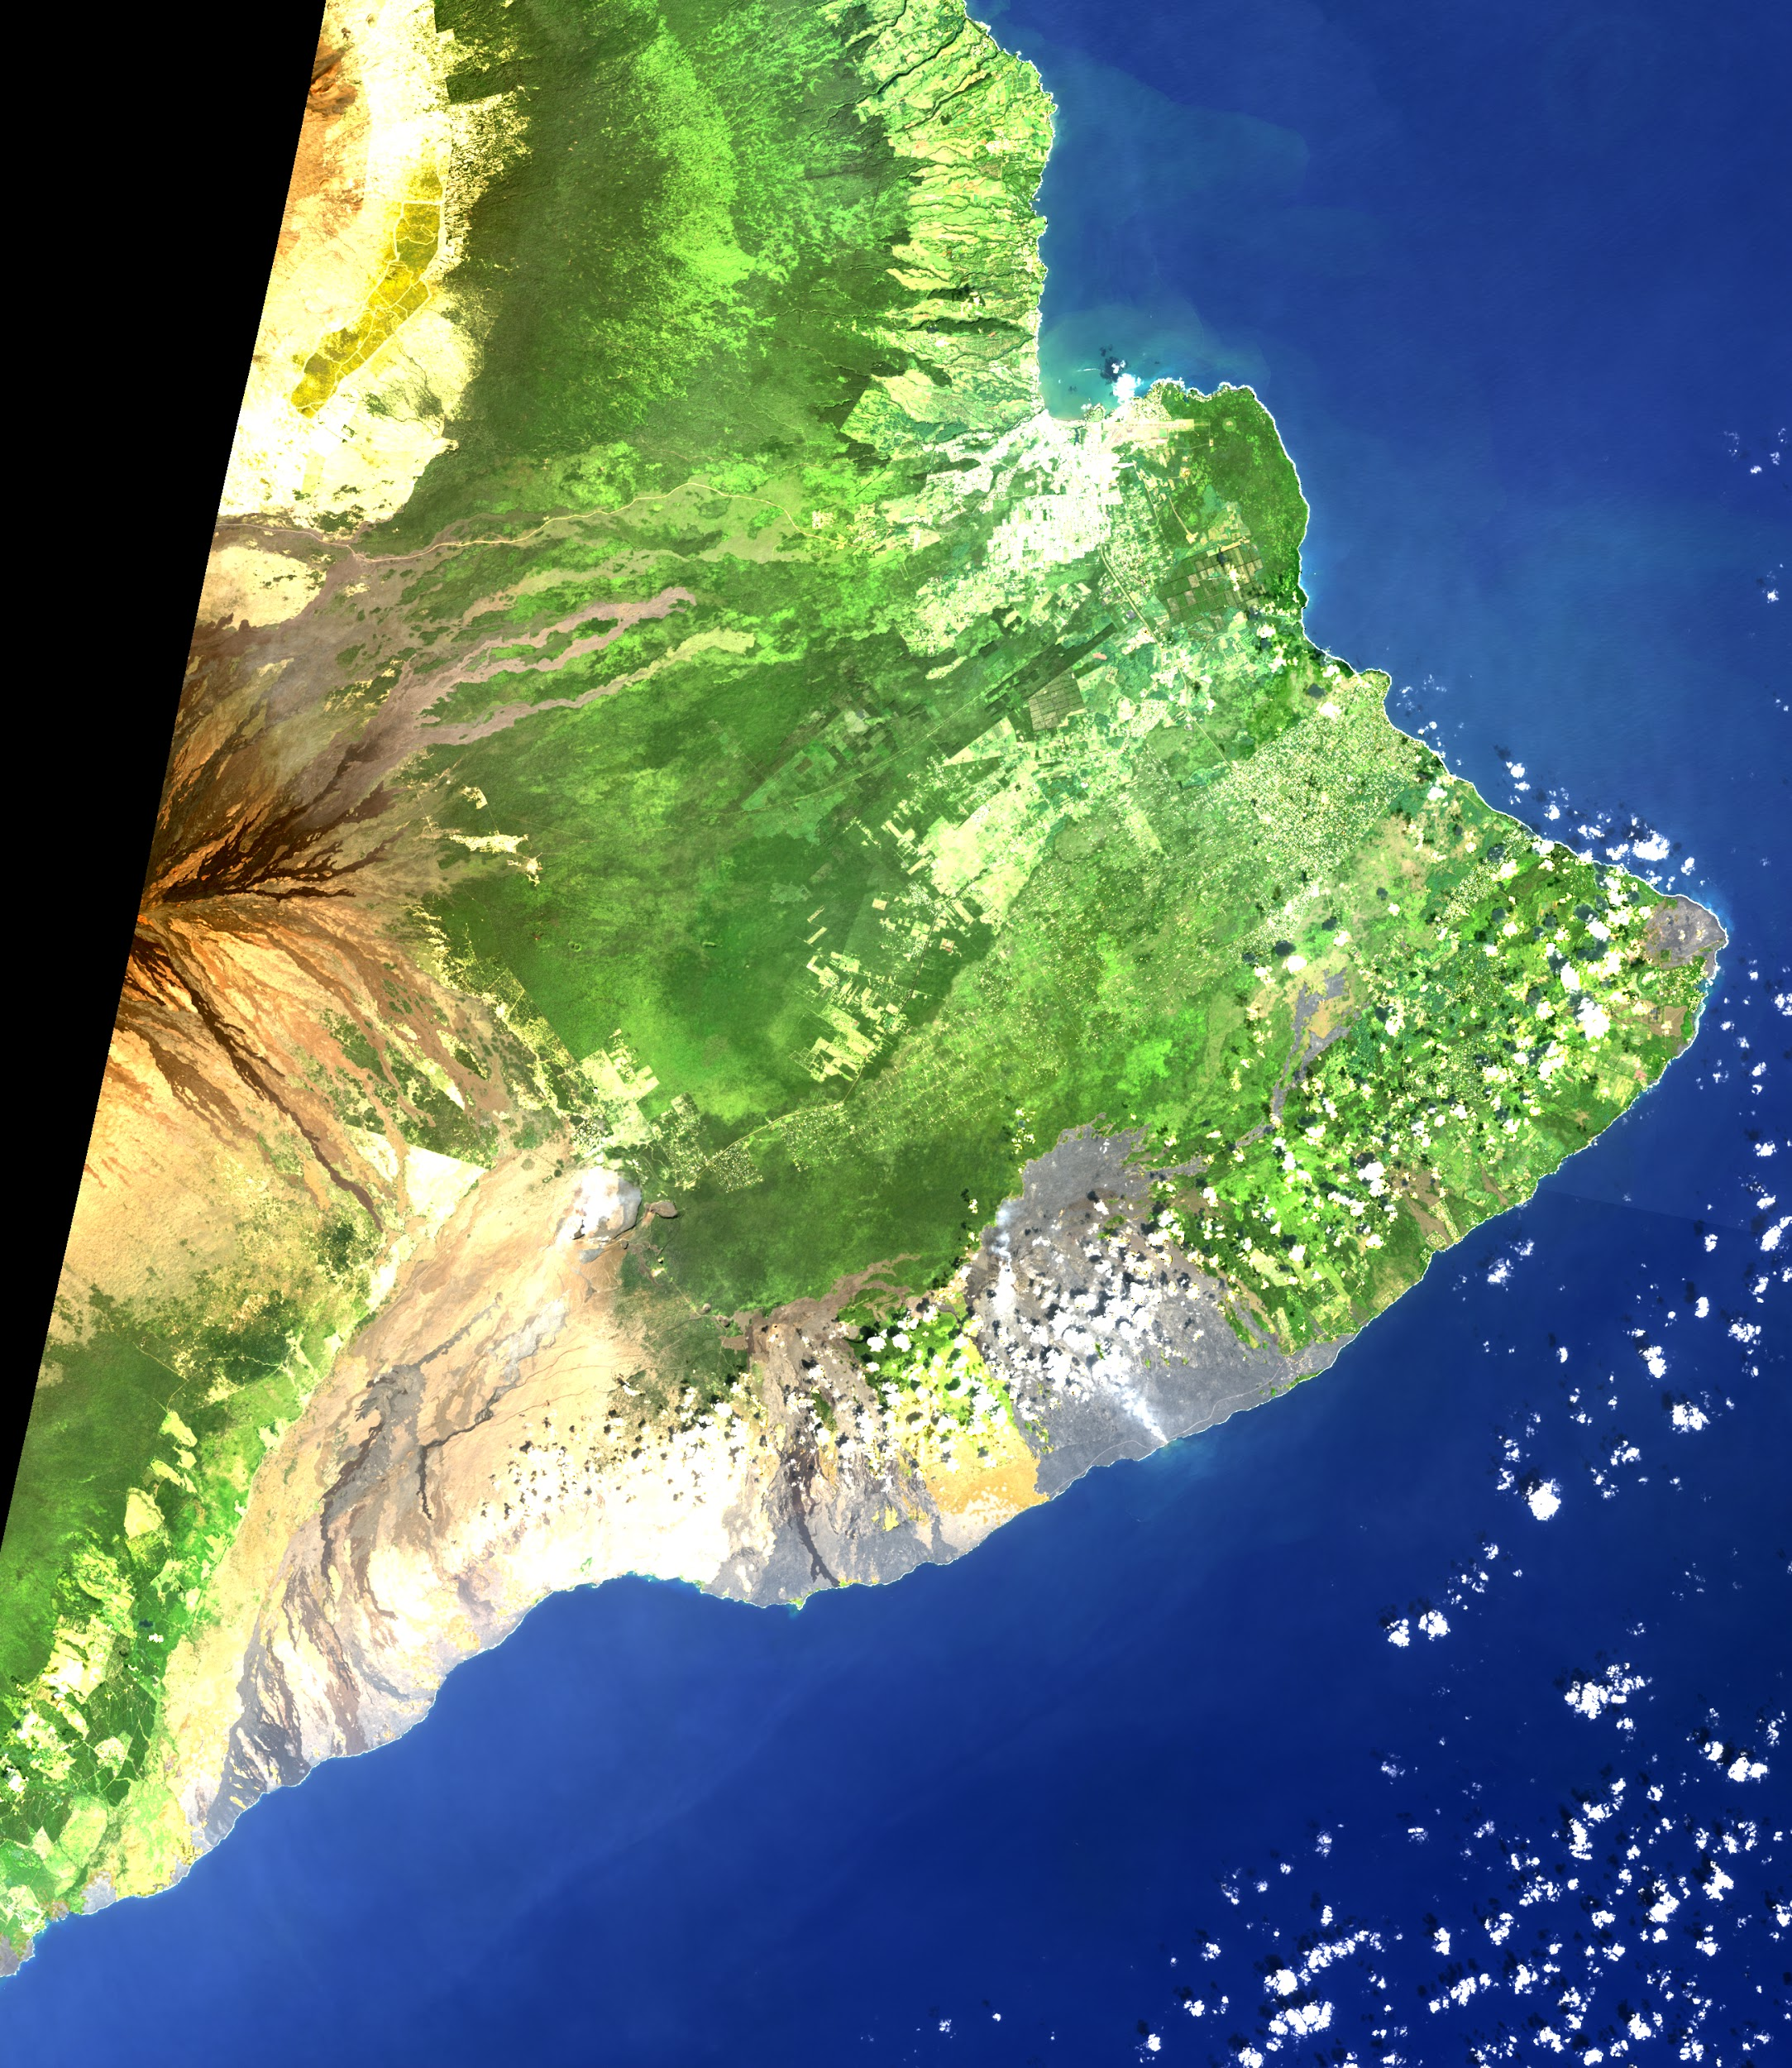
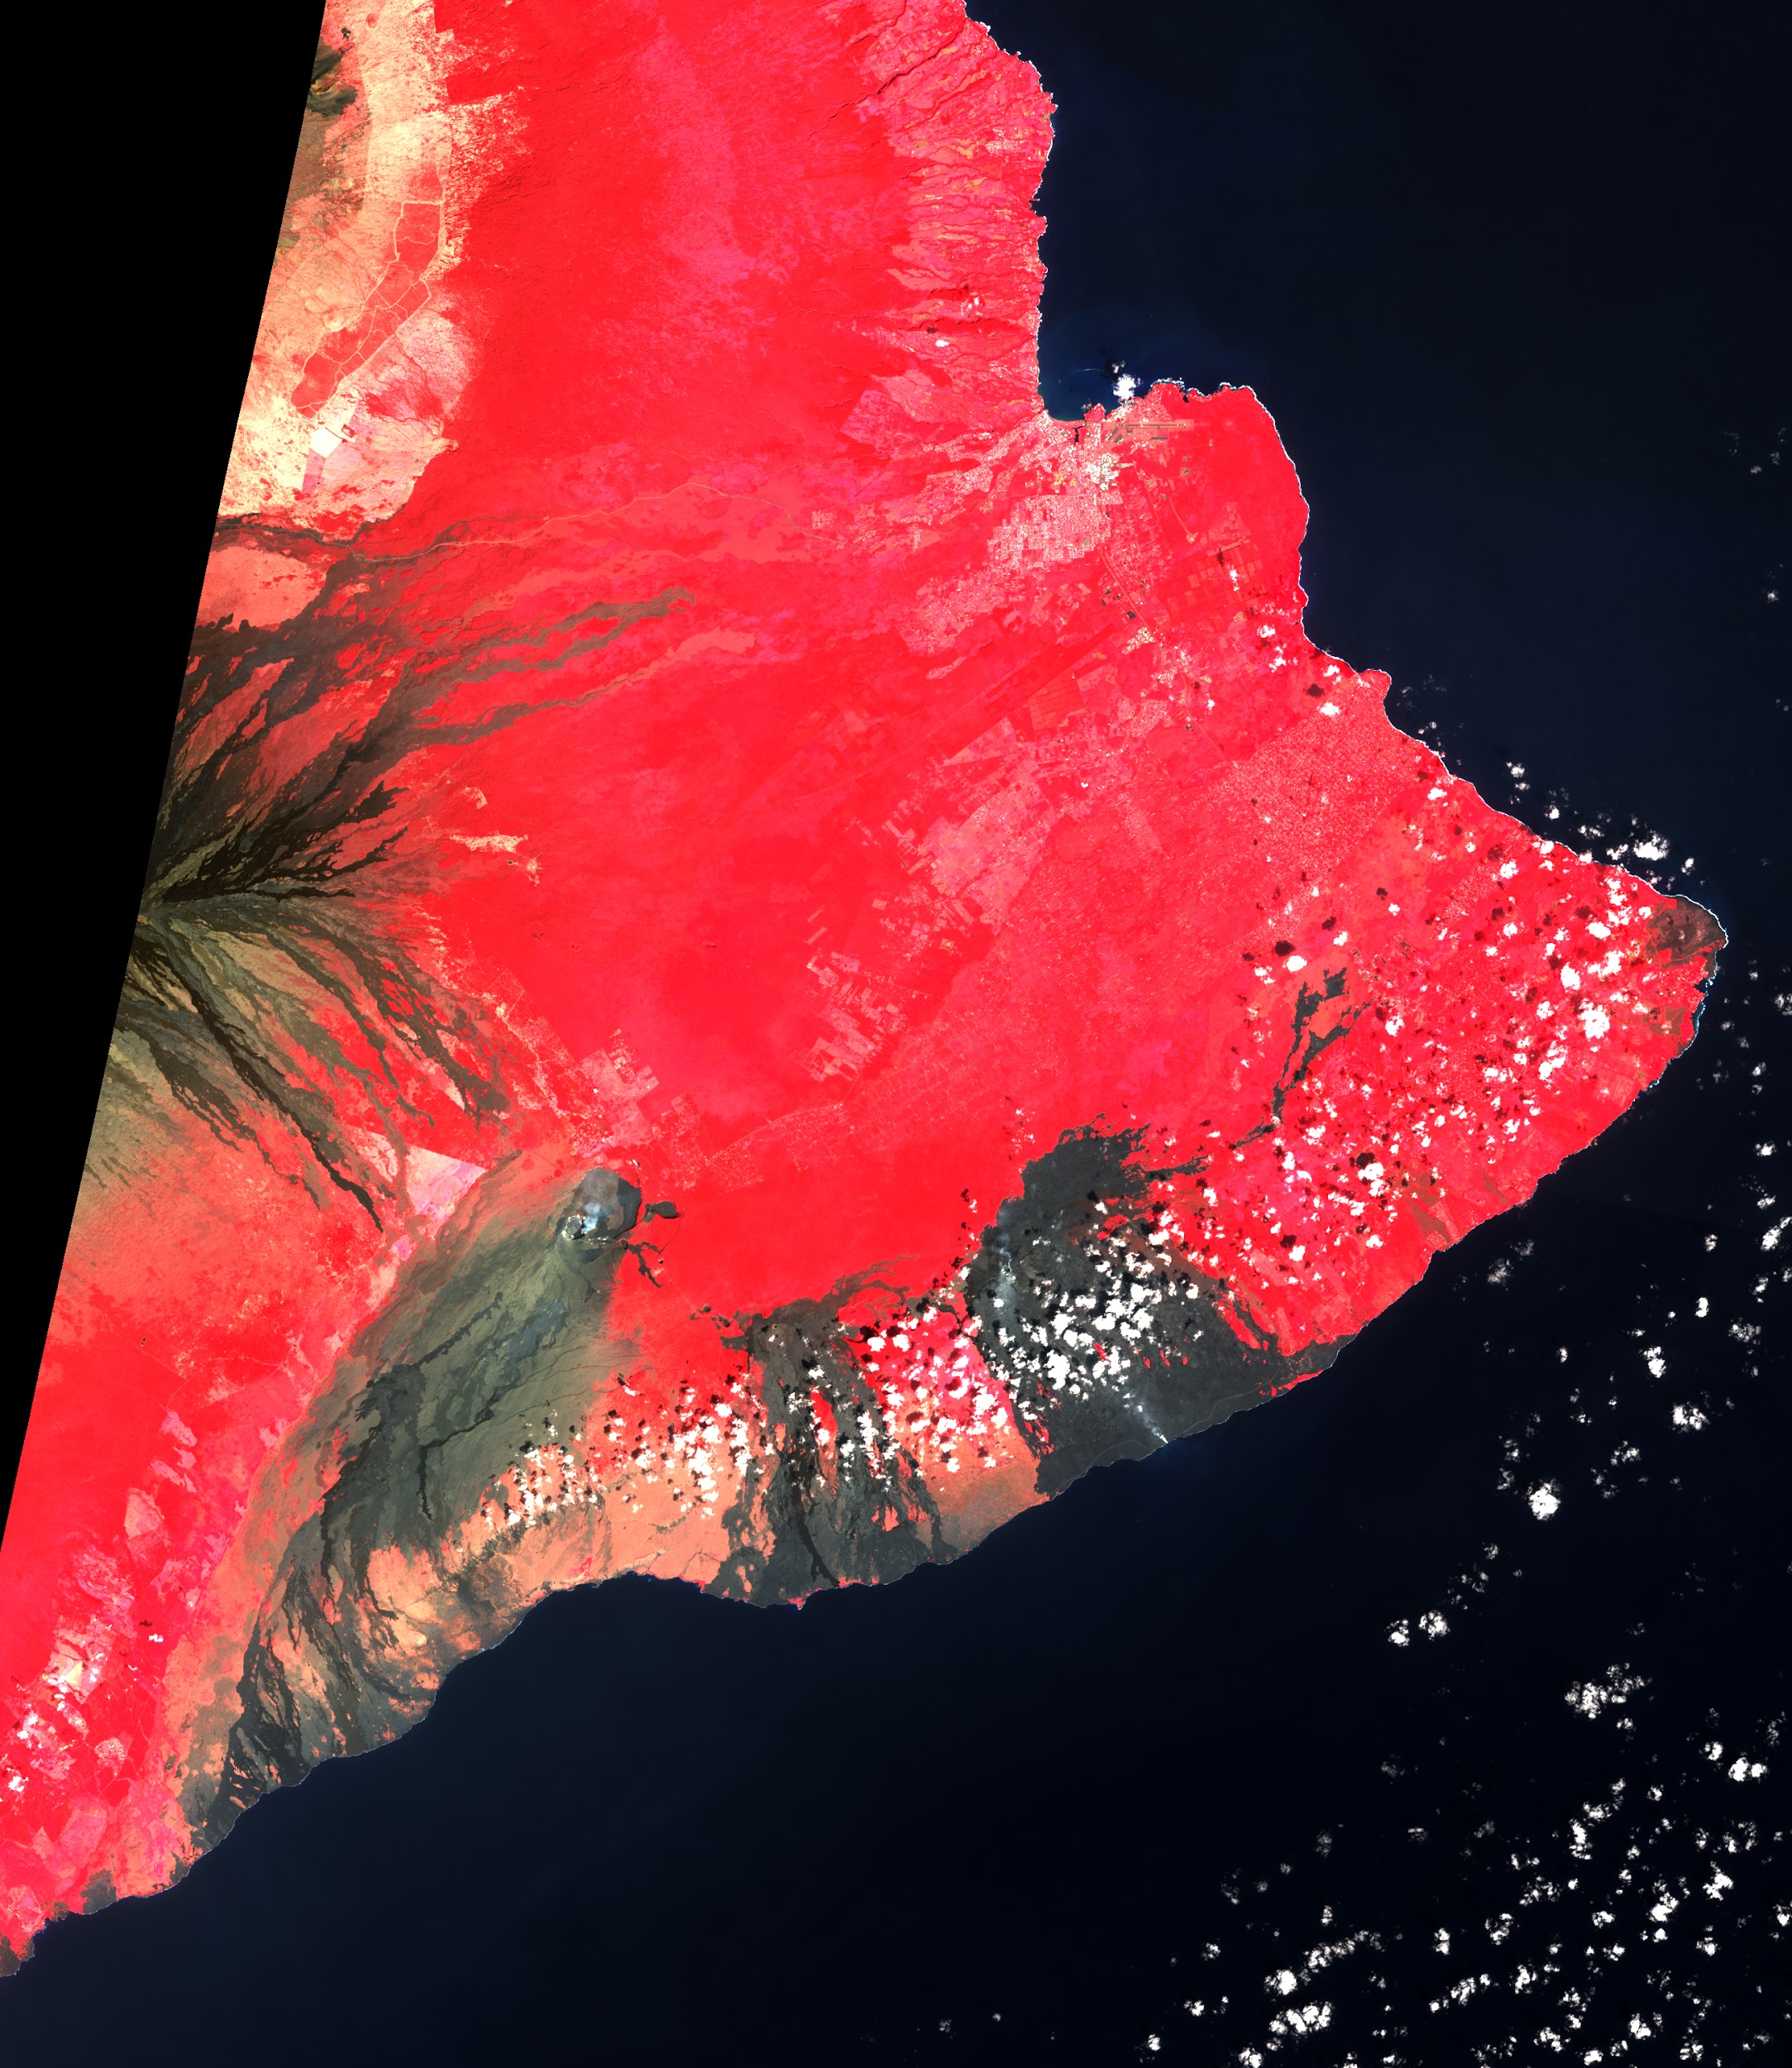
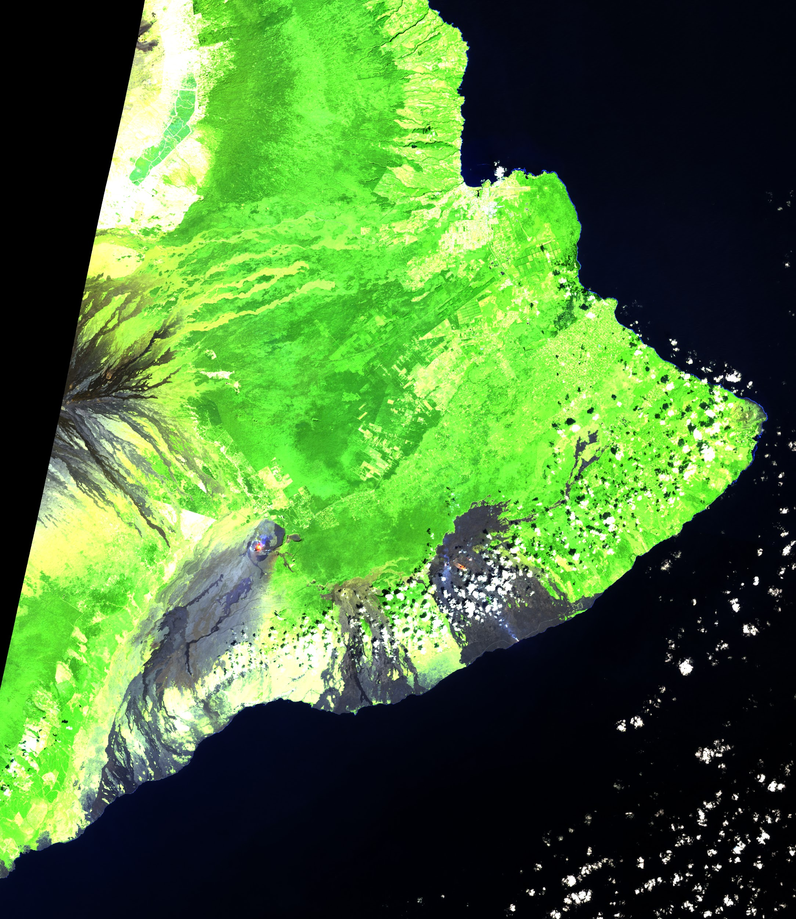
PROBLEM
QUESTION
ENHANCED MAPPING WITH PCA
Seven spectral bands cannot, of course, be imaged simultaneously.
Typically this is addressed by creating false color maps where non-visible bands are exchanged with visible colors.
What would we see if we were to conduct a dimensionality reduction via PCA from 7 bands to 3 components and image that?

Slide 7

ENHANCED MAPPING WITH PCA

Slide 8
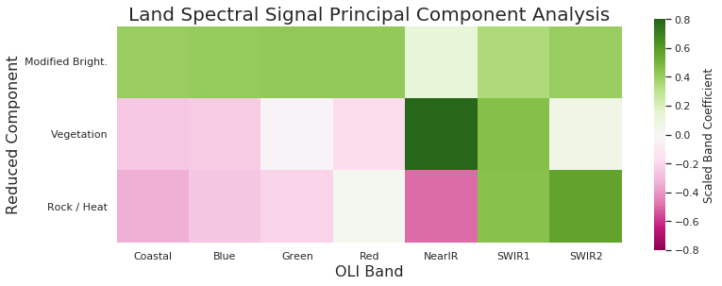
ENHANCED MAPPING WITH PCA
PCA conducted on land only
Component 1 - EVR 74%
“Brightness” biased against vegetation.
Component 2 - EVR 18%
Strong association with vegetation band 5; suspect soil (hydrated mineral signature) is in band 6.
Component 3 - EVR 6%
“Rockness”? “Heat”? Mid IR band 7 should be associated with non-hydrogen parts of mineral structure.

Slide 9
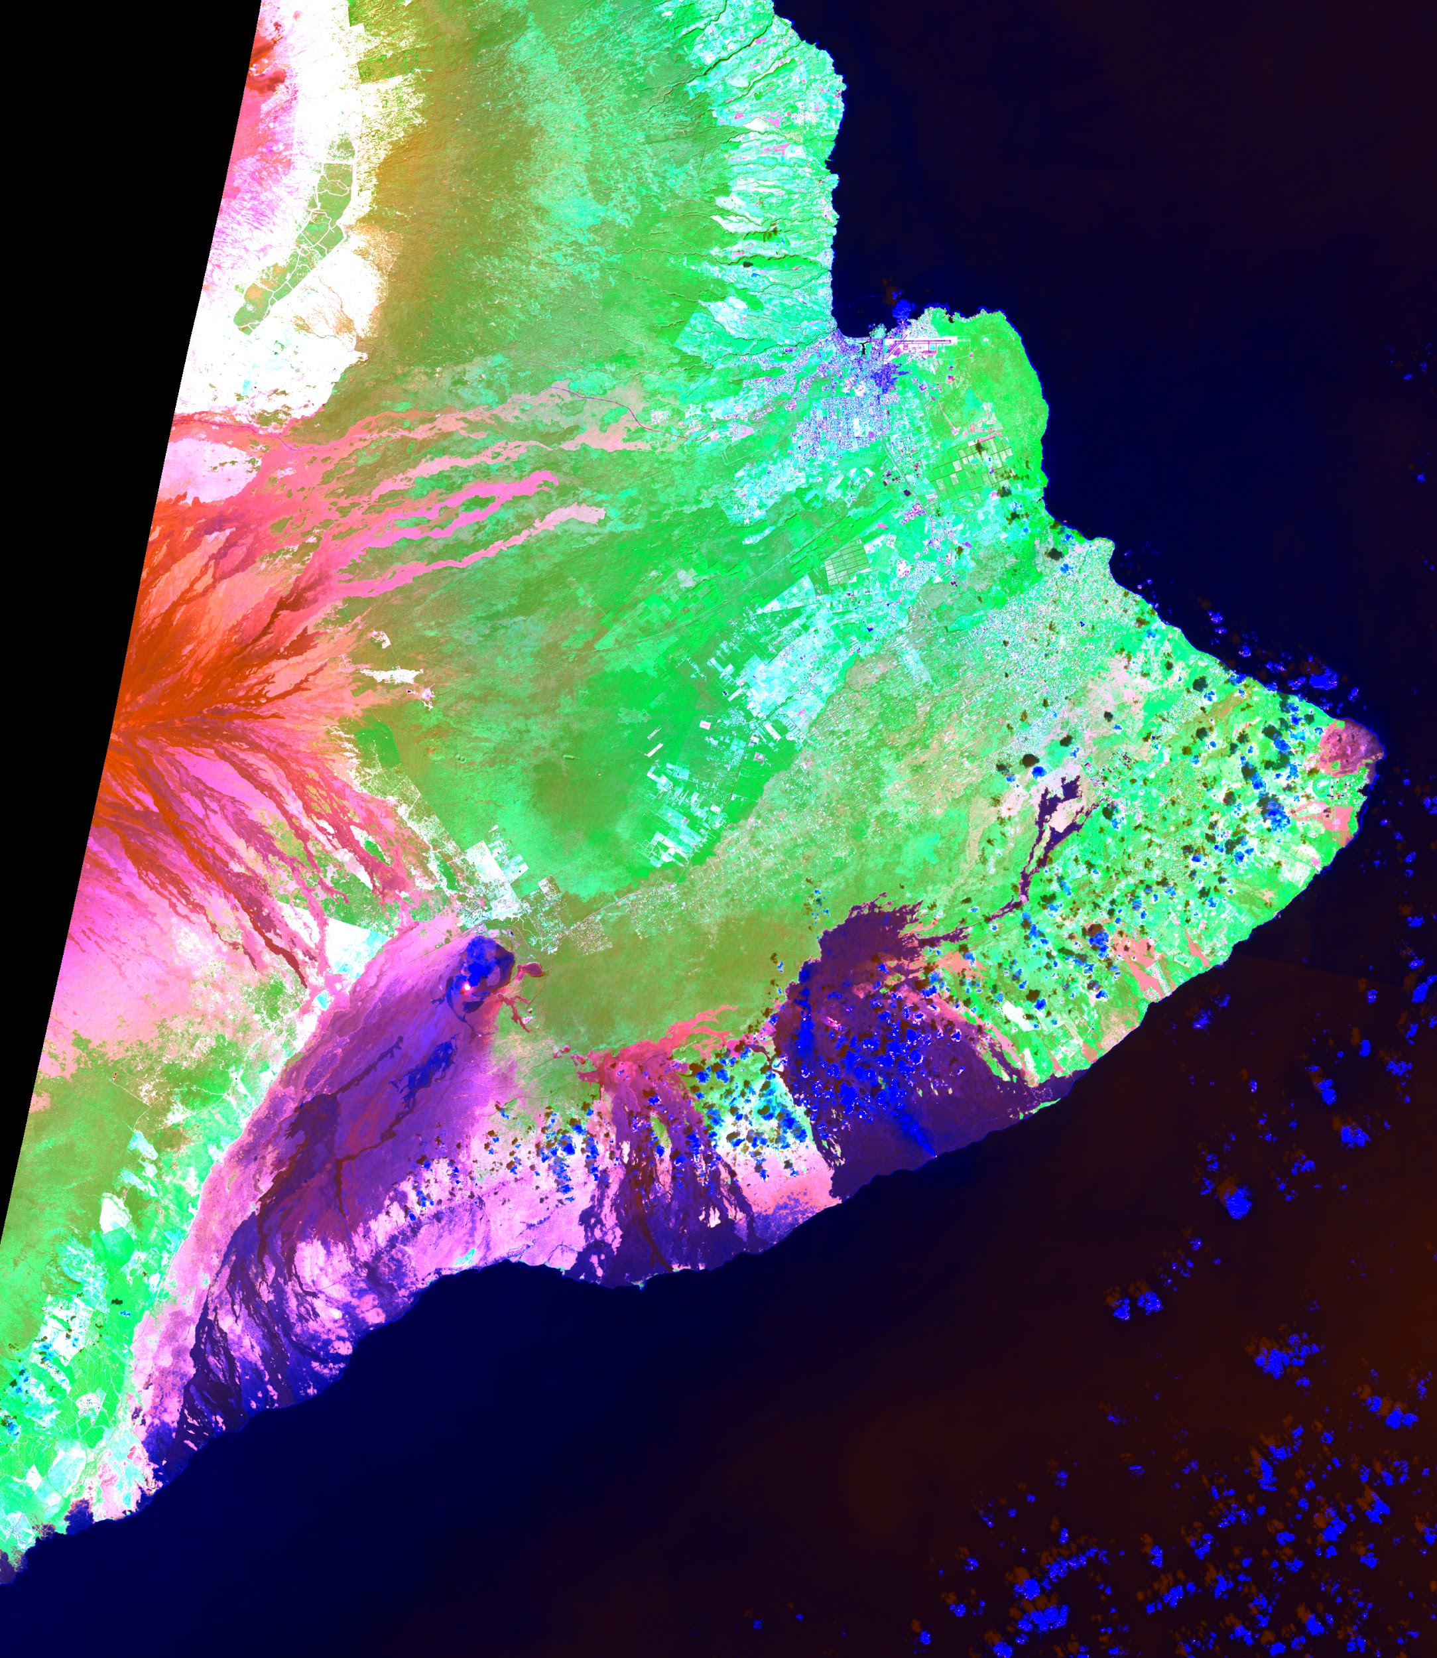
ENHANCED MAPPING WITH PCA
Red = rock / heat
Green = vegetation
Blue = “brightness”
Enhanced contrast here for newer lava flows. (In other places, the opposite is true.)
Note red (rock, not bright) color of high, dry Mauna Loa lava flows compared to lower lying Kilauea caldera and flows (purple, rock + bright).

Slide 10
ENHANCED MAPPING WITH PCA
Lava lakes:
prominent in PCA 3 rock/heat
Steam plume from lava entering ocean
bright in PCA 1
Red = rock / heat
Green = vegetation
Blue = “brightness”

Slide 11
ENHANCED MAPPING WITH PCA
Red = rock / heat
Green = vegetation
Blue = “brightness”
Greatly enhanced contrast for Hilo streets, structures, airport runways.

Slide 12
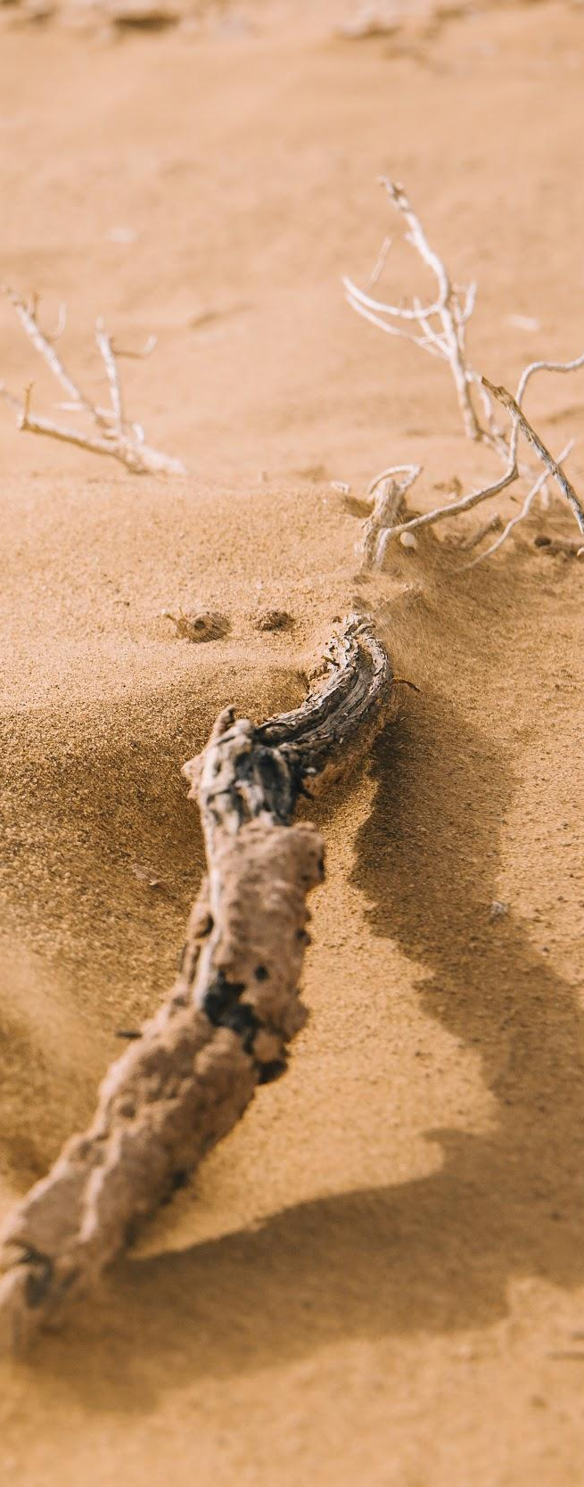
WHY CLUSTERING?
LANDSCAPE CLUSTERING
Classification would be preferable, but would require labels.
Geospatial data are usually labeled for classification via application of shapefiles, which was a bridge too far for the scope of this project. Mastering enough geospatial raster data formatting and software to do any analysis already took a week, and that followed a week of sifting through project ideas.
Clustering always holds the added attraction that it allows reality to tell us what’s going on, rather than the other way around (at least to some extent).

Slide 13
CLUSTERING METHODOLOGY
LANDSCAPE CLUSTERING
Sample down to <~ 50,000 pixels.
Standard scale and reduce dimensionality with PCA. Clustering on full dimensional space was unsuccessful. Cluster on pure spectral data to get spectral categories. Cluster on spatial + spectral data to get individual terrain objects.
DBSCAN and Mean Shift algorithms:
Avoid imposing a preset k on the dataset.
Both algorithms can be used to cluster (leaving data points as noise) rather than partition.
Gridsearch across hyperparameter space:
DBSCAN: core point distance, core number
Mean Shift: window size

Slide 14
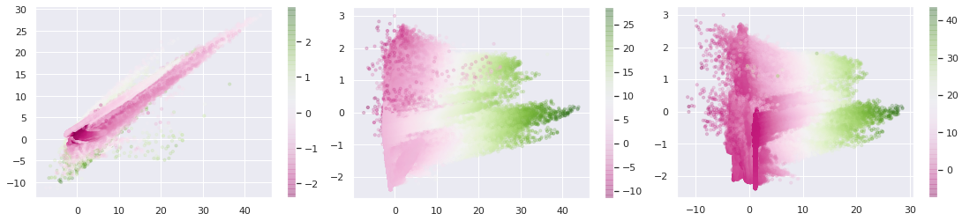
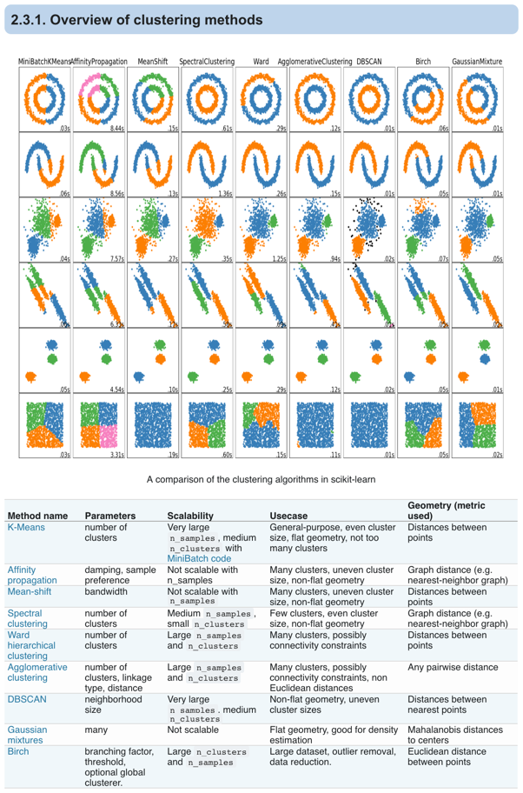
CLUSTERING METHODOLOGY
LANDSCAPE CLUSTERING
Reduce dimensionality with PCA.
DBSCAN and Mean Shift algorithms:
Avoid imposing a preset k.
Cluster (leaving data points as noise) rather than partition.
Gridsearch across hyperparameter space:
DBSCAN:
core point distance
core number
Mean Shift:
window size

Slide 15
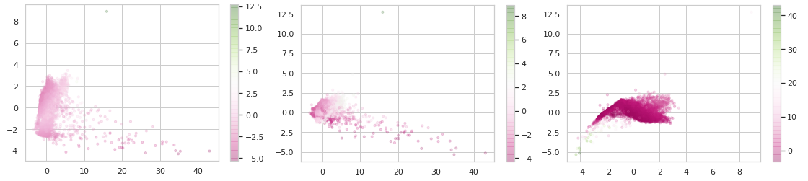
LANDSCAPE CATEGORIES
LANDSCAPE CLUSTERING
Spectral 7 channel data reduced to 3 PCA dimensions.
There is structure to this data, but it’s not easy to tease out.

Slide 16
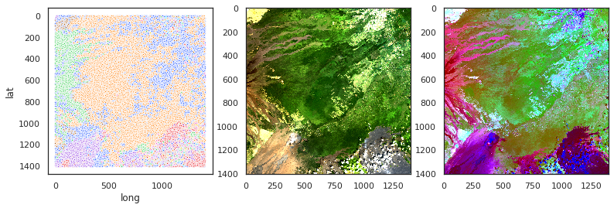
LANDSCAPE CATEGORIES
LANDSCAPE CLUSTERING
Mean Shift: window size 0.676 scaled units,
40% of estimate_bandwidth
Number of clusters: 186 (??!!)
Number of noise points: 22142
out of 39367 sampled pixels

Slide 17
LANDSCAPE OBJECTS
LANDSCAPE CLUSTERING
If you thought seven spectral dimensions was crazy… here’s the first three PCA components for ten-dimensional lat / long / elevation + spectral data.
There appears to be some weird rod-shaped structure in there.
This is the sort of data where DBSCAN performs better at clustering: high aspect ratio bodies.

Slide 18
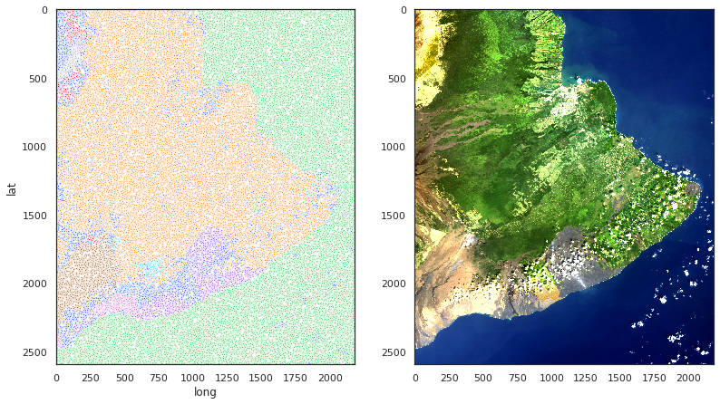
LANDSCAPE OBJECTS
LANDSCAPE CLUSTERING
DBSCAN: Core distance and core number:
0.20 scaled units, 25 points for core
Number of clusters: 16
Number of noise points: 8360
out of 56718 sampled pixels

Slide 19
APPLICATIONS
LANDSCAPE CLUSTERING
Volcanic hazard mapping:
Not every ocean island or other basaltic province has been mapped as carefully as Hawai’i.
Transferable methodology example:
Mapping contaminant distribution via stressed vegetation.

Slide 20
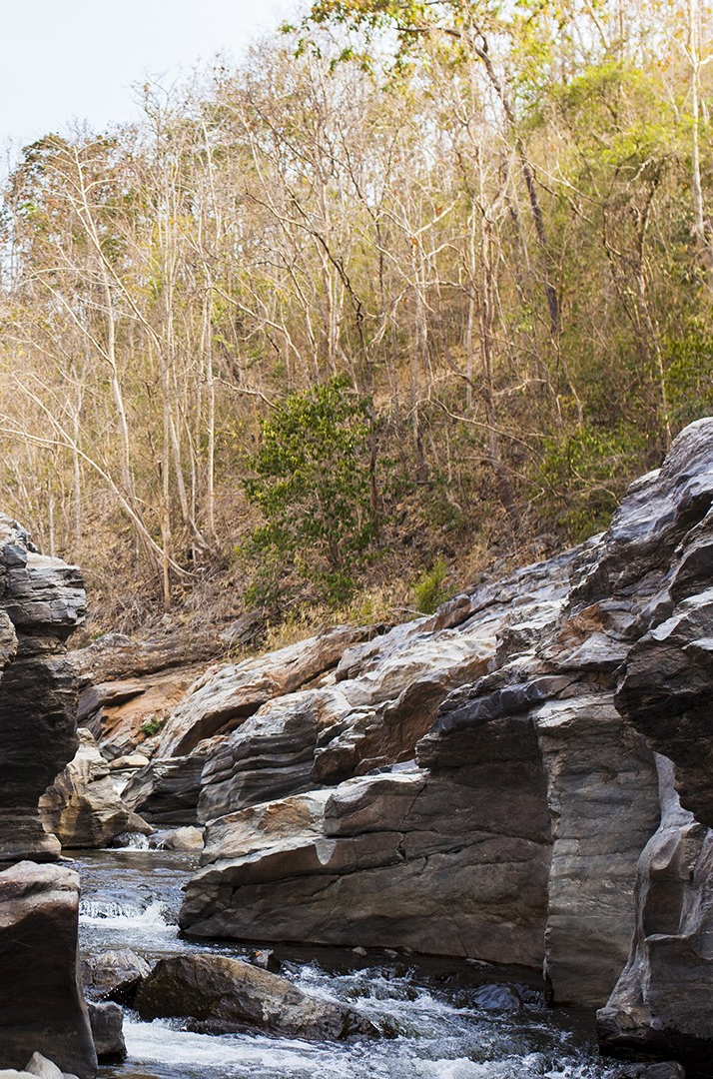
CREDITS
CREDITS
Landsat 8 data collected by NASA and served by USGS.
GRASS GIS from U.S. ACE et al.
Particularly helpful tutorial on Medium by Robert Simmon dealing with the GDAL library and geospatial image data in general.
Many other online sources of help!
Presentation template by Slidesgo
Icons by Flaticon
Infographics by Freepik
Author introduction slide photo created by Freepik
Text & Image slide photo created by Freepik.com

Slide 21
APPENDIX
Existing algorithms and software
Future work

Slide 22
BUT HASN’T THIS ALL BEEN DONE BEFORE?
LANDSCAPE CLUSTERING
Well… mostly.
GRASS GIS i.cluster + i.maxlik routines:
their own special sauce clustering algorithm, not quite k-means.
10 classes selected as input parameter, but some form of regularization removed one.
I don’t feel bad about being outdone by a project with this many contributor-hours.

Slide 23
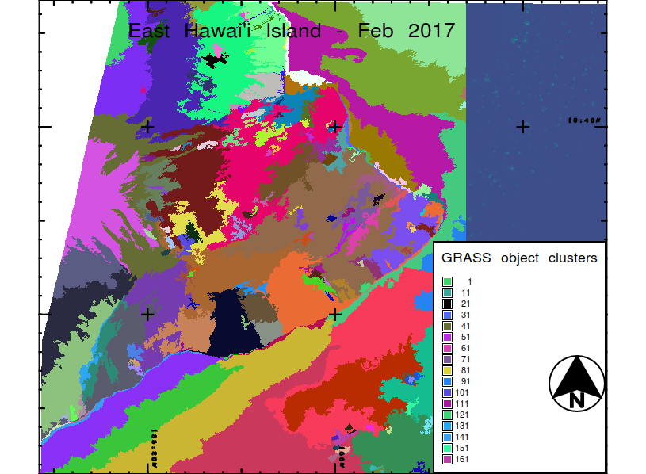
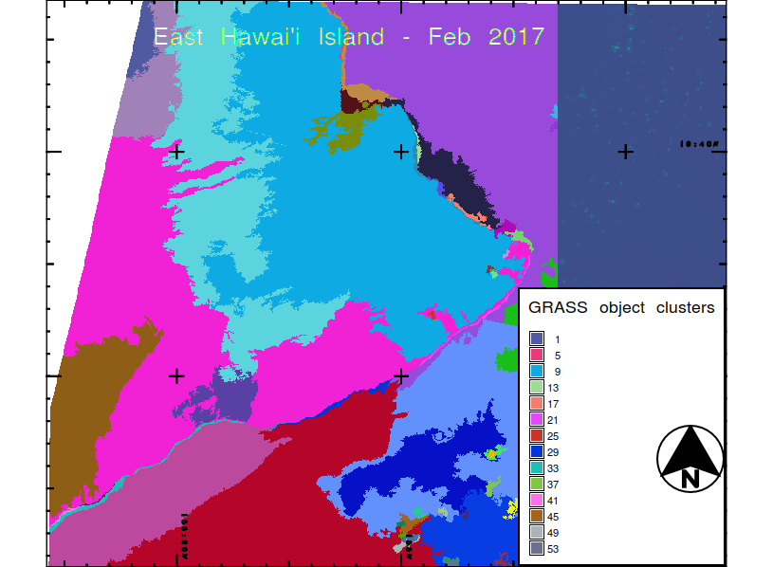
BUT HASN’T THIS ALL BEEN DONE BEFORE?
LANDSCAPE CLUSTERING
GRASS GIS i.segment routine used recursively / hierarchically (iterations 5 and 6 shown, thresholds 0.75 and 0.90).
Overall this is still superior, but there are a few advantages already apparent in using my alternative implementation.
(I don’t split the ocean, for example.)

Slide 24
Where to go from here?
Used advanced computing resources (Dask, Spark) on a remote instance to cluster all data.
Autoencoder to develop alternative reduced dimension spaces in which to cluster.
The original plan was to do initial exploration with clustering before moving to neural network classifiers.
There are several landscape classification training sets on TensorFlow alone to explore.
Train or find a pretrained model to then specialize to Hawai’i.
Tileserver to upgrade app so that large images can be served with short lag time.
Eventually attack the original motivating question: regress lava flow ages.
Find or create shapefiles for dated lava flows to use as training data.
Carefully construct & evaluate network to train it to recognize the difference between windward and leeward landscapes.
A solid model for lava flow age regression could be used to study volcanic hazards.
Similar methodology could attack questions like imaging stressed vegetation to infer contaminant distributions.

